Slide 1
ASP.NET Core Web API and HTTP

Slide 2
Objectives
ASP.NET Web API Architecture
Environment Setup for ASP.NET Core Web API
Demo: Create a simple web API with ASP.NET Core
Test the ASP.NET Core Web API using http-repl, Postman
ControllerBase class
Middleware in ASP.NET Core Web API
Configure Middleware Components
Routing in ASP.NET Core Web API Application

Slide 3
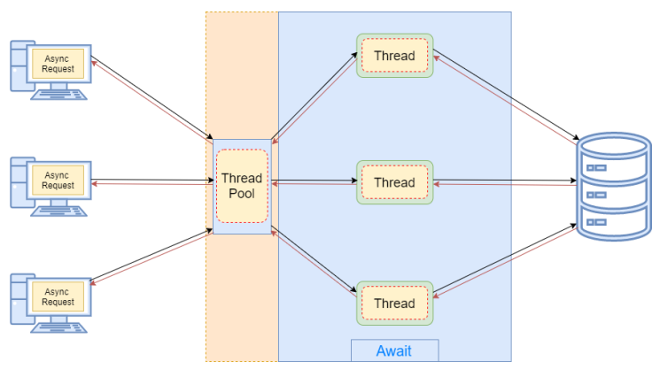
Asynchronous code
Async programming is a parallel programming technique that allows the working process to run separately from the main application thread.
As soon as the work completes, it informs the main thread about the result whether it was successful or not.
By using async programming, we can avoid performance bottlenecks and enhance the responsiveness of our application.

Slide 4
Asynchronous code - 2
The async and await keywords play a crucial part in asynchronous programming. By using those keywords, we can easily write asynchronous methods without too much effort.
In asynchronous programming, we have three return types:
Task<TResult>, for an async method that returns a value.
Task, for an async method that does not return a value.
void, which we can use for an event handler.

Slide 5
ASP.NET Introduction
ASP.NET = A unified web stack
ASP.NET 4.6 (WebForms, MVC, Web API, Web Pages)
ASP.NET Core 1.0 Web API+MVC
ASP.NET Core 2.0 Web API+MVC+Razor Pages
ASP.NET Core vNext Web API+MVC+Razor Pages +SignalR

Slide 6
ASP.NET Core
ASP.NET Core is a cross-platform, high-performance, open-source framework for building modern, cloud-enabled, Internet-connected apps.
With ASP.NET Core, you can:
Build web apps and services, Internet of Things (IoT) apps, and mobile backends.
Use your favorite development tools on Windows, macOS, and Linux.
Deploy to the cloud or on-premises.
Run on .NET Core.

Slide 7
ASP.NET Core Benefits - 1
A unified story for building web UI and web APIs.
Architected for testability.
Razor Pages makes coding page-focused scenarios easier and more productive.
Blazor lets you use C# in the browser alongside JavaScript. Share server-side and client-side app logic all written with .NET.
Ability to develop and run on Windows, macOS, and Linux.
Open-source and community-focused.

Slide 8
ASP.NET Core Benefits - 2
Integration of modern, client-side frameworks and development workflows.
Built-in dependency injection.
A lightweight, high-performance, and modular HTTP request pipeline.
Ability to host on the following: Kestrel, IIS, HTTP.sys, Nginx, Apache, Docker

Slide 9
ASP.NET Web API Architecture -1
Async all the way: The ASP.NET Web API framework has been designed using the task-based asynchronous programming model from the top to the bottom.
Replicating the same HTTP pipeline in client library as well as server library. This helps with unifying the programming model as well as ease of integration testing because you can short circuit the client–server communication and bypass the network by connecting the client pipeline directly to the server pipeline.
Ability to host both in IIS (or development server) and in any nonweb server process (called self-hosted).

Slide 10
ASP.NET Web API Architecture - 2
Built-in support for dependency injection: ASP.NET Web API supports any custom dependency injection framework through a simple service location interface.
Service location even for components of the framework itself: You can customize many elements of ASP.NET Web API by supplying your own custom implementation.
Ultimate testability: ASP.NET Web API has been designed with testing in mind.
HttpConfiguration: The ASP.NET Web API runtime context is abstracted and represented in the HttpConfiguration class. HttpConfiguration is a central place for defining different aspects of the runtime and does not have static properties, making it more testable.

Slide 11
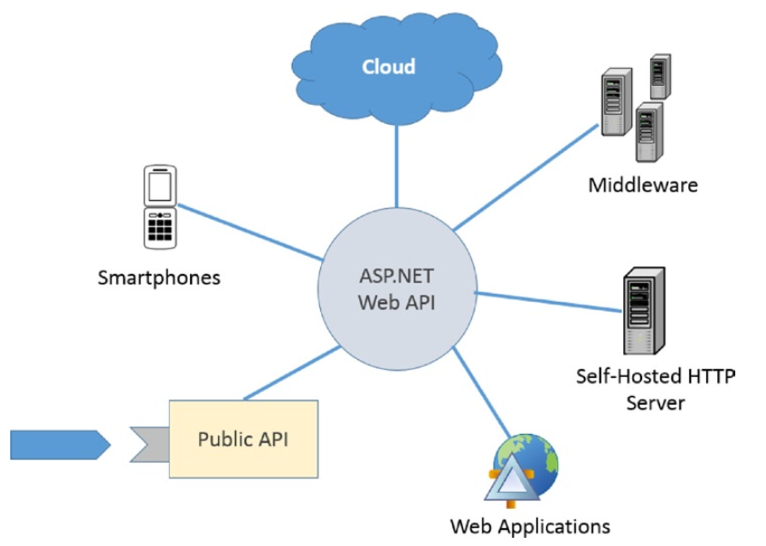
ASP.NET Web API Architecture - 3

Slide 12
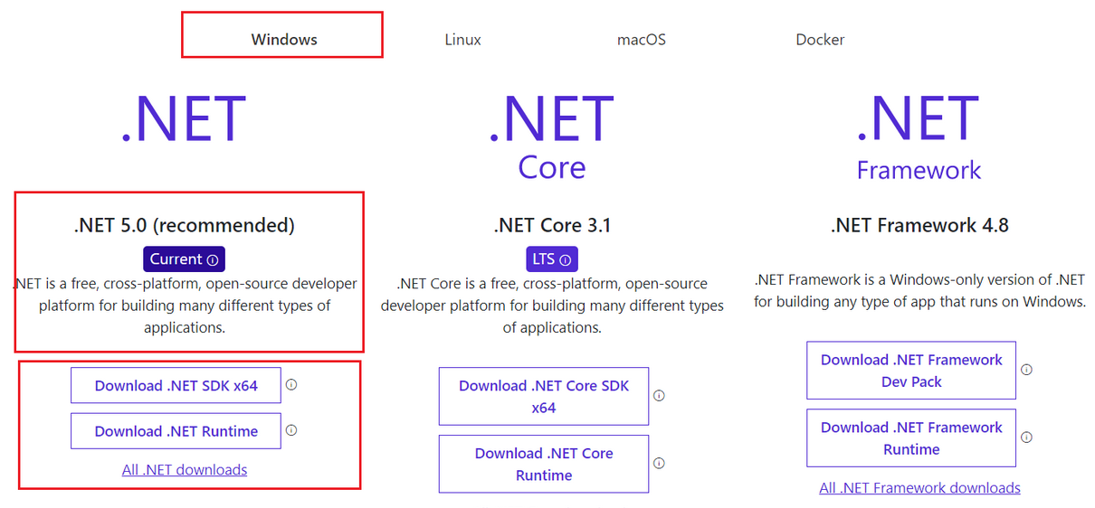
Environment Setup for ASP.NET Core Web API
Notes:
https://docs.microsoft.com/en-us/aspnet/core/fundamentals/environments?view=aspnetcore-5.0

Slide 13
Demo: Create a web API with ASP.NET Core
Step 1. Create a web API project.
Step 2. Add a model class and a database context.
Step 3. Scaffold a controller with CRUD methods.
Step 4. Configure routing, URL paths, and return values.
Step 5. Call the web API with Postman/ http-repl.

Slide 14
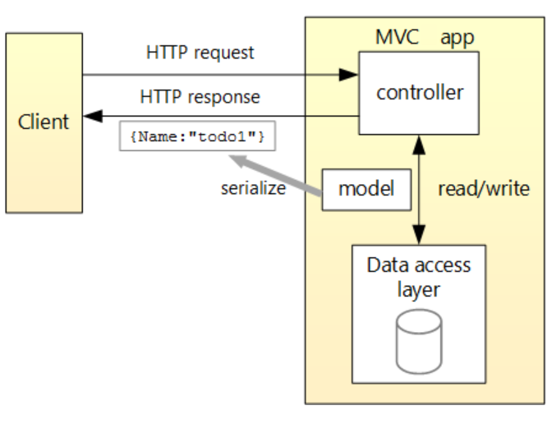
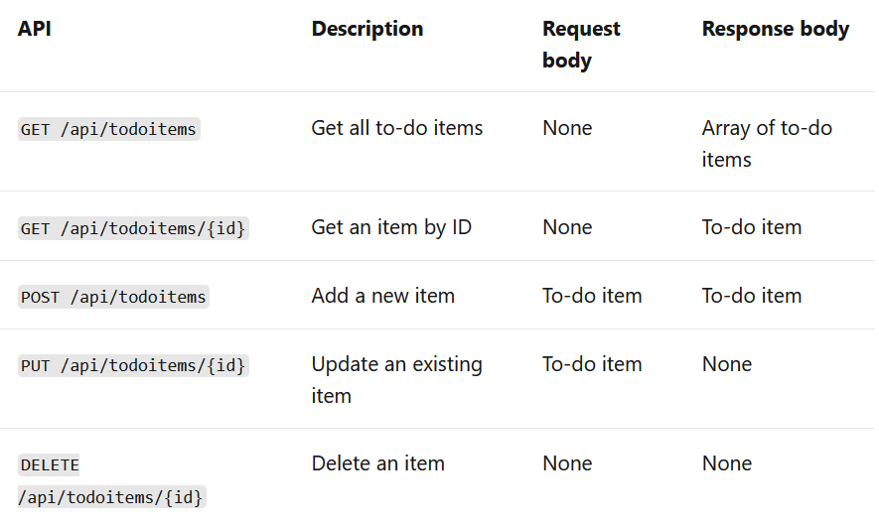
Create a web API with ASP.NET Core - 2
Notes:
https://docs.microsoft.com/en-us/aspnet/core/tutorials/first-web-api?view=aspnetcore-5.0

Slide 15
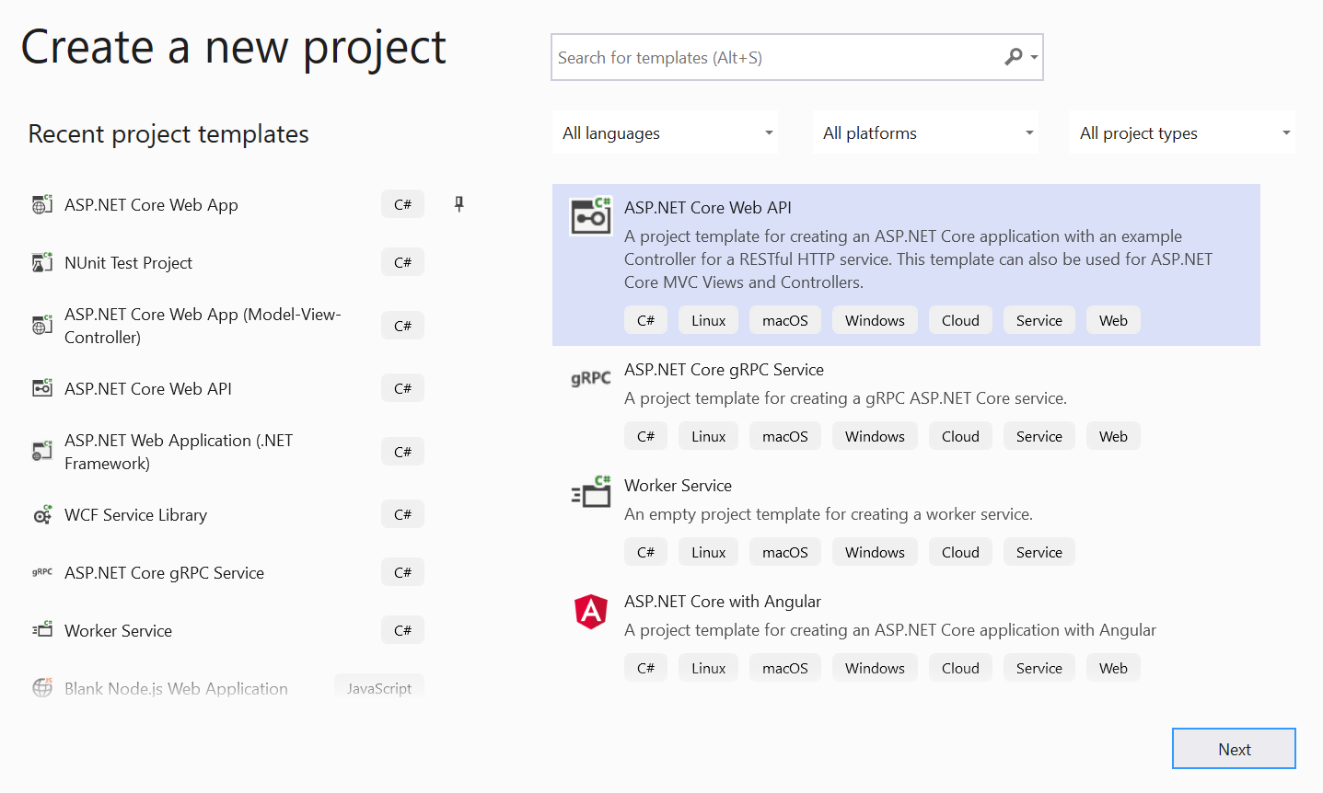
Creating ASP.NET Core Web API Project
Using .NET Core CLI (Command Line Interface)
dotnet new webapi: a new project will be created inside the CLI folder with the default name.
dotnet new webapi –name MyFirstWebAPIProject: .NET Core CLI will create a project inside the CLI folder with the name MyFirstWebAPIProject.
Using Visual Studio 2019

Slide 16
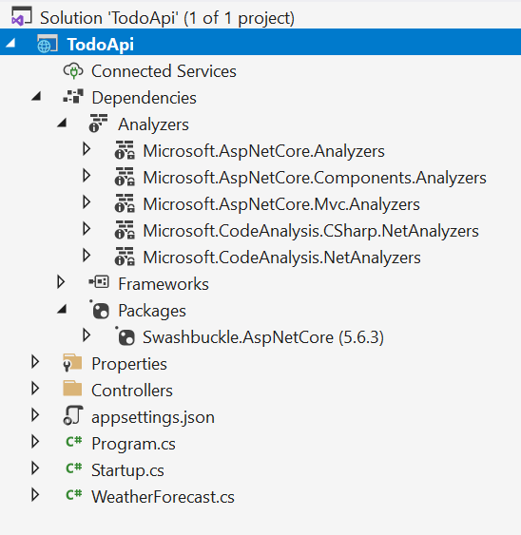
ASP.NET Core Web API Files and Folders - 1
Packages
Frameworks
Packages that are required for the .NET core are available inside Microsoft.NETCore.App.
Packages which are specific to ASP.NET Core will reside inside Microsoft.AspNetCore.App
Analyzers - The analyzers will work with controllers annotated with ApiControllerAttribute while building on web API conventions.
Controllers - All the controllers of your ASP.NET Core Web API Application should and must reside inside the Controllers folder.

Slide 17
ASP.NET Core Web API Files and Folders - 2
Startup.cs class
The ConfigureServices method of the Startup class is the place where we can register our dependent classes with the built-in IoC container.
The Configure method of the Startup class is the place where we configure the application request pipeline using the IApplicationBuilder instance that is provided by the built-in IoC container.
appsettings.json file - The appsettings.json file is the application configuration file in ASP.NET Core Web Application used to store the configuration settings (database connections strings, any application scope global variables, etc.)

Slide 18
ASP.NET Core Web API Files and Folders - 3
appsettings.Development.json - Configure some settings based on the environments in appsettings.{Environment}.json file.
Program.cs class file
launchSettings.json file
This configuration determines the launch behavior of the ASP.NET Core applications.
It contains both configurations to launch settings for IIS and self-hosted applications (Kestrel).
Change the launchBrowser property to false to prevent the web browser from launching on application start.

Slide 19
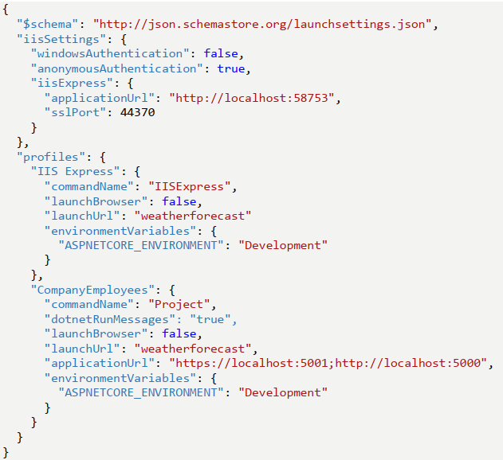
ASP.NET Core Web API Files and Folders - 4
Example of launchSettings.json

Slide 20
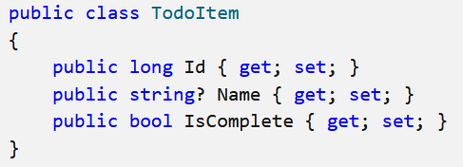
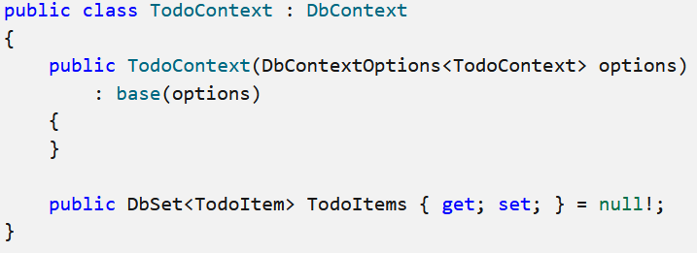
Model and Database context for Web API
Add a model class
Add a database context
Install package Microsoft.EntityFrameworkCore.InMemory

Slide 21
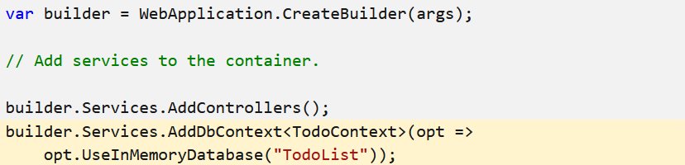
Register the database context
In ASP.NET Core, services such as the DB context must be registered with the dependency injection (DI) container. The container provides the service to controllers.

Slide 22
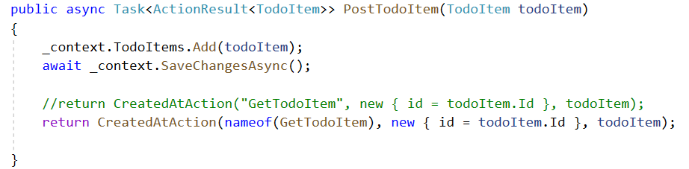
Implement the other CRUD operations - 1
Scaffold a controller. Choose API Controller with actions, using Entity Framework.
In the Add API Controller with actions, using Entity Framework dialog:
Choose TodoItem (TodoApi.Models) in the Model class.
Choose TodoContext (TodoApi.Models) in the Data context class.
Update the return statement in the PostTodoItem to use the nameof operator

Slide 23
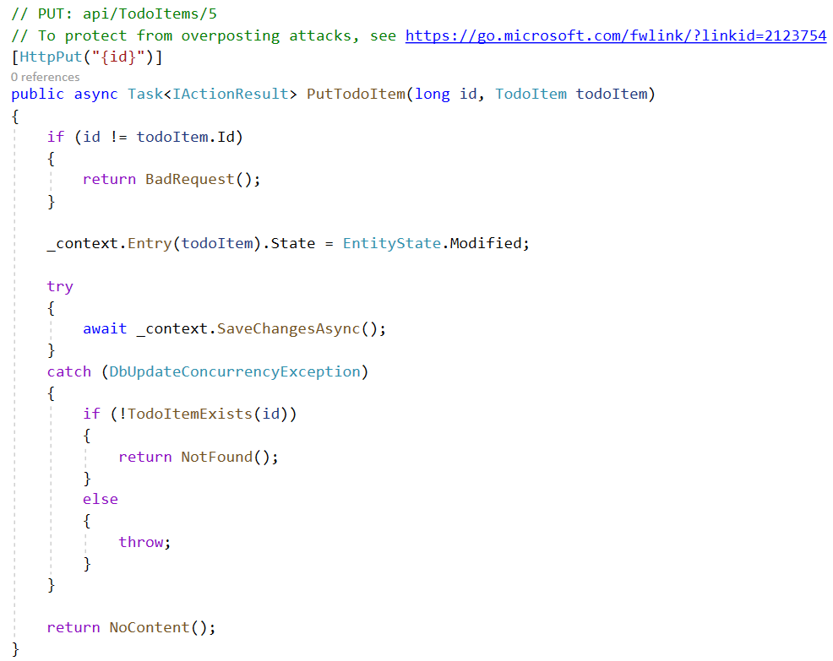
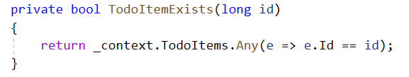
Implement the other CRUD operations - 2
Change the code in PUT method

Slide 24
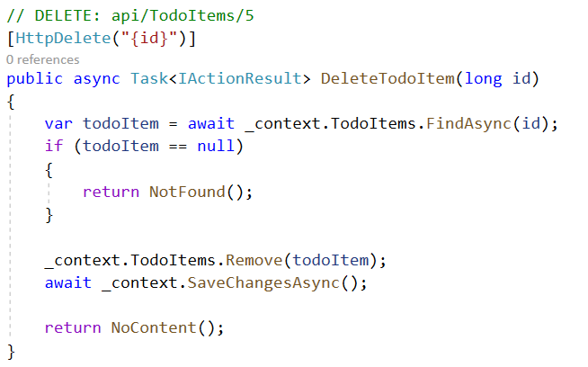
Implement the other CRUD operations - 3
Change the code in DELETE method

Slide 25
Test the ASP.NET Core Web API using http-repl
Install package http-repl.
dotnet tool install -g Microsoft.dotnet-httprepl
Test POST method
httprepl https://localhost:5001/api/todoitems
post -h Content-Type=application/json -c "{"name":"walk dog","isComplete":true}"
Test GET method
connect https://localhost:5001/api/todoitems/1
get

Slide 26
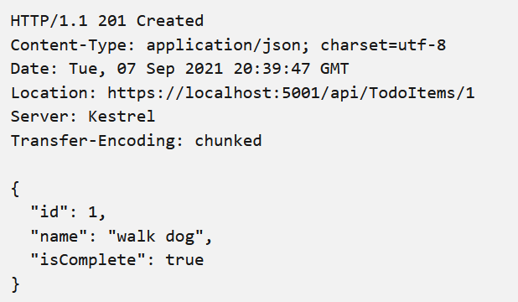
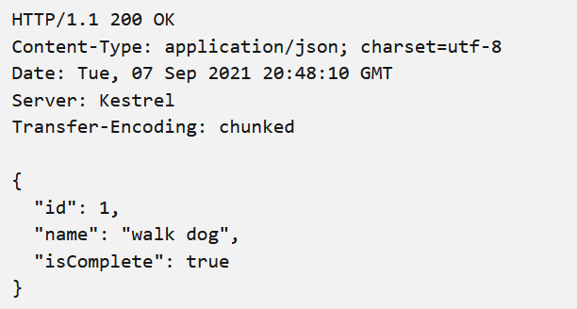
Test the ASP.NET Core Web API using http-repl

Slide 27
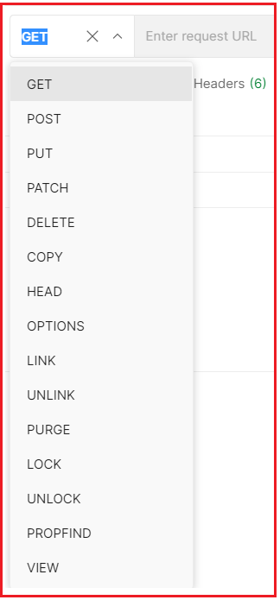
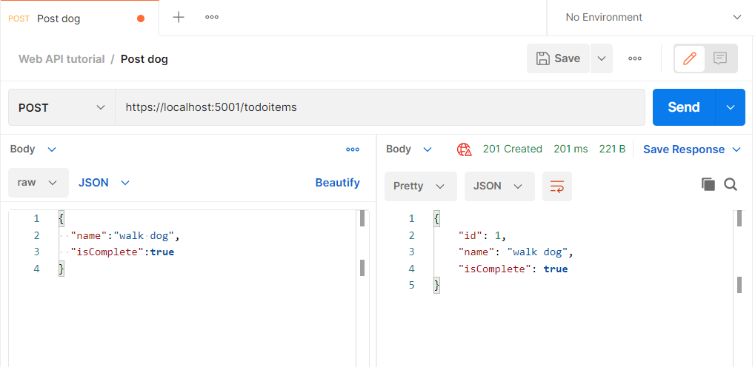
Test the ASP.NET Core Web API using Postman

Slide 28
ControllerBase class
A Web API consists of one or more controller classes that derive from ControllerBase class.
Several methods of ControllerBase class.
Method | Notes
BadRequest | Returns 400 status code.
NotFound | Returns 404 status code.
PhysicalFile | Returns a file.
TryUpdateModelAsync | Invokes model binding.
TryValidateModel | Invokes model validation.
Notes:
https://docs.microsoft.com/en-us/dotnet/api/microsoft.aspnetcore.mvc.controllerbase?view=aspnetcore-5.0

Slide 29
Attributes
The Microsoft.AspNetCore.Mvc namespace provides attributes that can be used to configure the behavior of web API controllers and action methods. The following example uses attributes to specify the supported HTTP action verb and any known HTTP status codes that could be returned:
Attribute | Notes
[Route] | Specifies URL pattern for a controller or action.
[Bind] | Specifies prefix and properties to include for model binding.
[HttpGet] | Identifies an action that supports the HTTP GET action verb.
[Consumes] | Specifies data types that an action accepts.
[Produces] | Specifies data types that an action returns.

Slide 30
Binding source parameter inference
A binding source attribute defines the location at which an action parameter's value is found.
Attribute | Binding source
[FromBody] | Request body
[FromForm] | Form data in the request body
[FromHeader] | Request header
[FromQuery] | Request query string parameter
[FromRoute] | Route data from the current request
[FromServices] | The request service injected as an action parameter

Slide 31
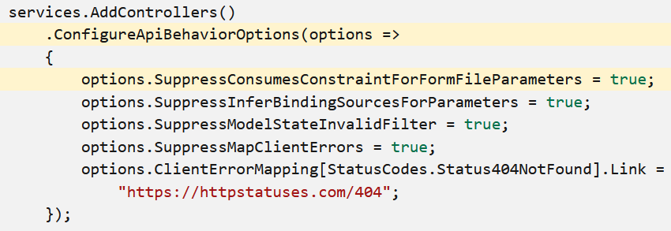
Multipart/form-data request inference
The [ApiController] attribute applies an inference rule when an action parameter is annotated with the [FromForm] attribute. The multipart/form-data request content type is inferred.
To disable the default behavior, set the SuppressConsumesConstraintForFormFileParameters property to true in Startup.ConfigureServices:

Slide 32
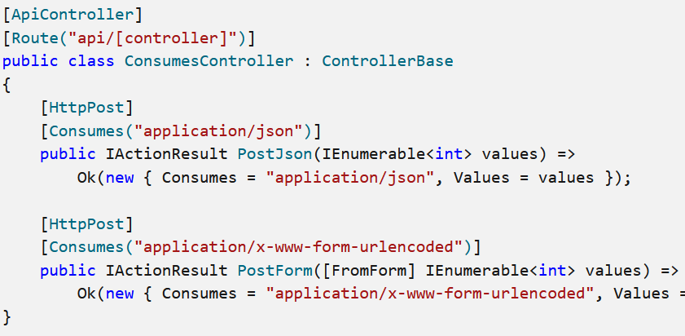
Define supported request content types
Define supported request content types with the [Consumes] attribute
The [Consumes] attribute allows an action to limit the supported request content types. Apply the [Consumes] attribute to an action or controller, specifying one or more content types

Slide 33
Controller action return types
ASP.NET Core offers the following options for web API controller action return types:
Specific type
IActionResult
ActionResult<T>

Slide 34


Controller action return types - Specific type
The simplest action returns a primitive or complex data type (for example, string or a custom object type).
Returns a collection of custom objects
Return IEnumerable<T> or IAsyncEnumerable<T>

Slide 35
Controller action return types - IActionResult
The IActionResult return type is appropriate when multiple ActionResult return types are possible in an action. The ActionResult types represent various HTTP status codes.
Some common return types in this category are BadRequestResult (400), NotFoundResult (404), and OkObjectResult (200). Alternatively, convenience methods in the ControllerBase class can be used to return ActionResult types from an action (BadRequest(); is a shorthand form of return new BadRequestResult();).
The [ProducesResponseType] attribute produces more descriptive response details for web API help pages generated by tools like Swagger.
[ProducesResponseType] indicates the known types and HTTP status codes to be returned by the action.

Slide 36
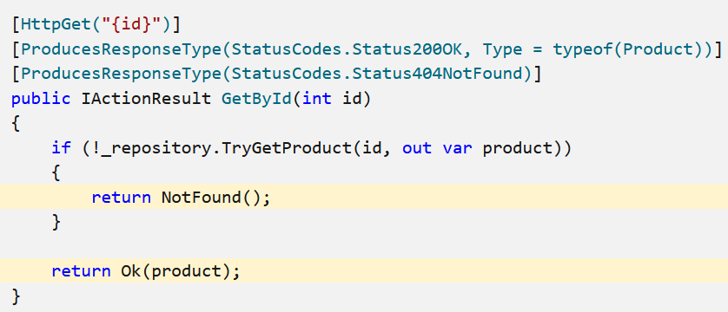
IActionResult – Example with Synchronous action
A 404 status code is returned when the product represented by id doesn't exist in the underlying data store. The NotFound convenience method is invoked as shorthand for return new NotFoundResult();.
A 200 status code is returned with the Product object when the product does exist. The Ok convenience method is invoked as shorthand for return new OkObjectResult(product);.

Slide 37
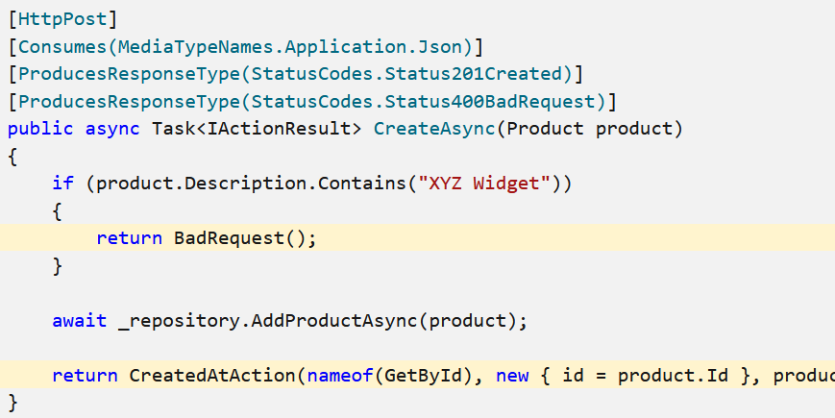
IActionResult – Example with Asynchronous action
A 400 status code is returned when the product description contains "XYZ Widget".
A 201 status code is generated by the CreatedAtAction convenience method when a product is created.

Slide 38
Handle errors in ASP.NET Core web APIs - 1
The Developer Exception Page is a useful tool to get detailed stack traces for server errors. It uses DeveloperExceptionPageMiddleware to capture synchronous and asynchronous exceptions from the HTTP pipeline and to generate error responses.
Exception handler
In non-development environments, Exception Handling Middleware can be used to produce an error payload

Slide 39
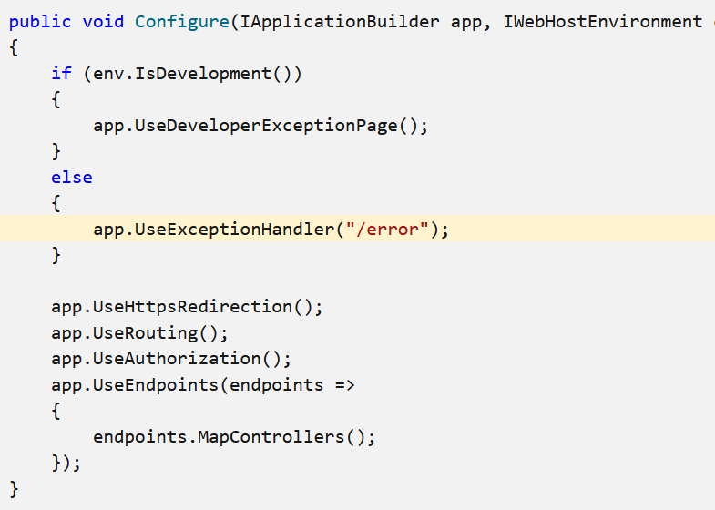
Handle errors in ASP.NET Core web APIs - 2

Slide 40
Controller action return types - ActionResult<T>
ASP.NET Core includes ActionResult<T> return type for web API controller actions. It enables you to return a type deriving from ActionResult or return a specific type. ActionResult<T> offers the following benefits over the IActionResult type:
The [ProducesResponseType] attribute's Type property can be excluded. For example, [ProducesResponseType(200, Type = typeof(Product))] is simplified to [ProducesResponseType(200)]. The action's expected return type is instead inferred from the T in ActionResult<T>.
Implicit cast operators support the conversion of both T and ActionResult to ActionResult<T>. T converts to ObjectResult, which means return new ObjectResult(T); is simplified to return T;.

Slide 41
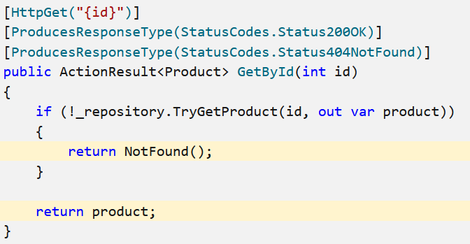
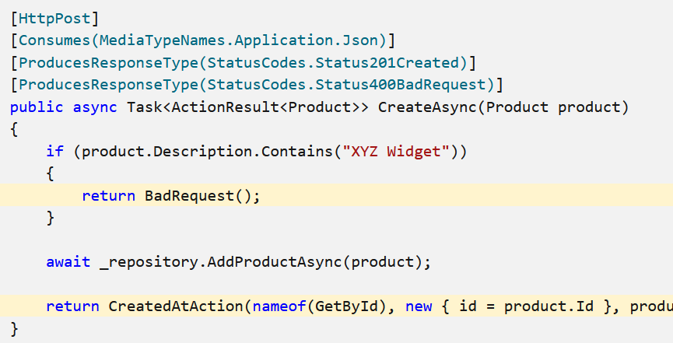
ActionResult<T> Examples

Slide 42
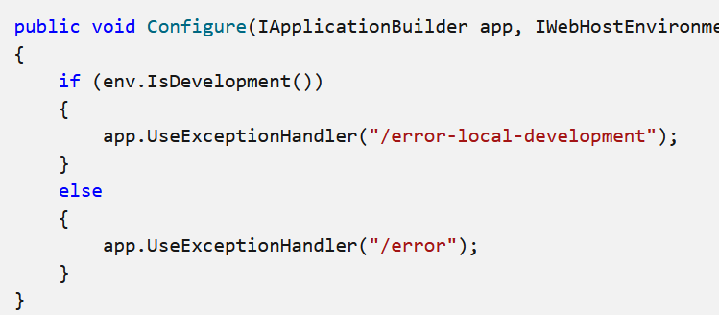
Handle errors in ASP.NET Core web APIs - 2
Exception Handling Middleware can also provide more detailed content-negotiated output in the local development environment. Use the following steps to produce a consistent payload format across development and production environments

Slide 43
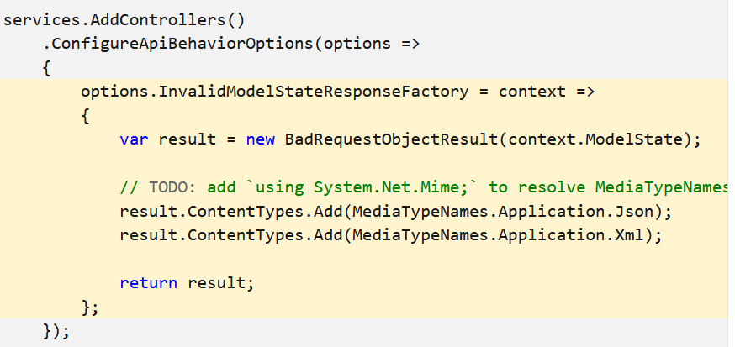
Handle errors in ASP.NET Core web APIs - 3
Validation failure error response

Slide 44
Documentation with Swagger / OpenAPI
Swagger (OpenAPI) is a language-agnostic specification for describing REST APIs.
It allows both computers and humans to understand the capabilities of a REST API without direct access to the source code. Its main goals are to:
Minimize the amount of work needed to connect decoupled services.
Reduce the amount of time needed to accurately document a service.
The two main OpenAPI implementations for .NET are Swashbuckle and NSwag

Slide 45
OpenApi vs. Swagger
OpenAPI is a specification.
Swagger is tooling that uses the OpenAPI specification. For example, OpenAPIGenerator and SwaggerUI.
The OpenAPI specification is a document that describes the capabilities of your API.
The document is based on the XML and attribute annotations within the controllers and models. It's the core part of the OpenAPI flow and is used to drive tooling such as SwaggerUI.

Slide 46
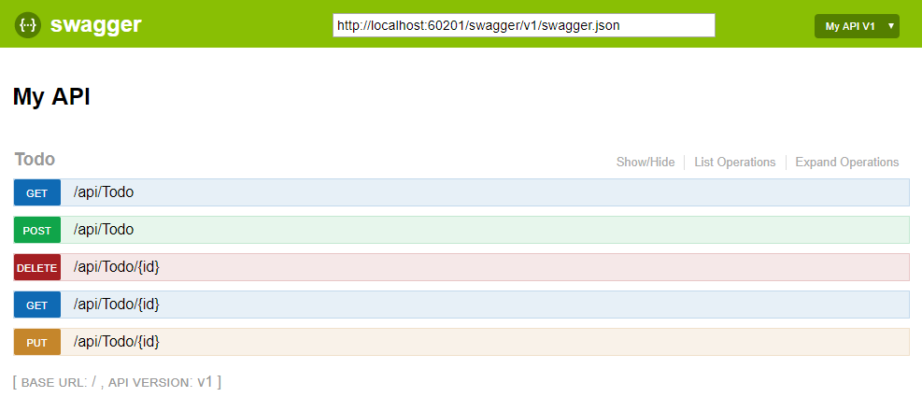
OpenApi vs. Swagger - 2
Swagger UI offers a web-based UI that provides information about the service, using the generated OpenAPI specification. Both Swashbuckle and NSwag include an embedded version of Swagger UI, so that it can be hosted in your ASP.NET Core app using a middleware registration call.

Slide 47
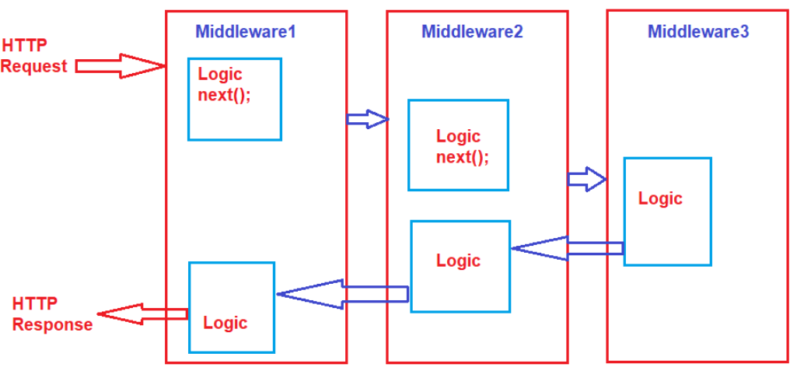
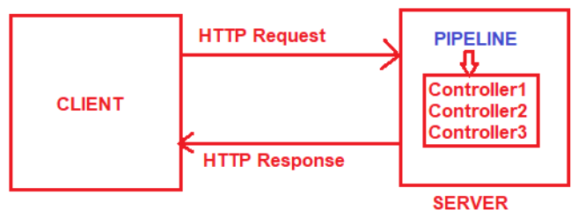
Middleware in ASP.NET Core Web API - 1
Middleware is one of the core functionalities of any ASP.NET Core Web Application.
HTTP Request Pipeline
Before hitting the controller action method, the request has to pass through a pipeline.
Once the pipeline is completed, then only it navigates the request to the corresponding controller action method.
The Request Pipeline in ASP.NET Core Web API Application can have multiple middlewares

Slide 48
Middleware in ASP.NET Core Web API - 2
Middleware is a piece of code that is used in the HTTP Request Pipeline.
An ASP.NET Core Web API Application can have n numbers of middleware.
Each middleware in the ASP.NET Core Web API Application performs the following tasks.
Chooses whether to pass the HTTP Request to the next component in the pipeline. This can be achieved by calling the next() method within the middleware.
Can perform work before and after the next component in the pipeline.
ASP.NET Core provides some built-in middleware that is ready to be used, even if you want then you can also create your own custom middleware.

Slide 49
Middleware in ASP.NET Core Web API - 3
Middleware Examples:
Routing: Implement Routing in your application, then you need to use Routing Middleware in the HTTP Request Processing pipeline.
Authentication: Authenticate the user then you need to use Authentication Middleware.
Authorize: The Authorize Middleware is used to Authorize the users while accessing a specific resource.
Log: Log request and response while processing, then you need Middleware.
Exception Middleware: Handle the exception globally.

Slide 50
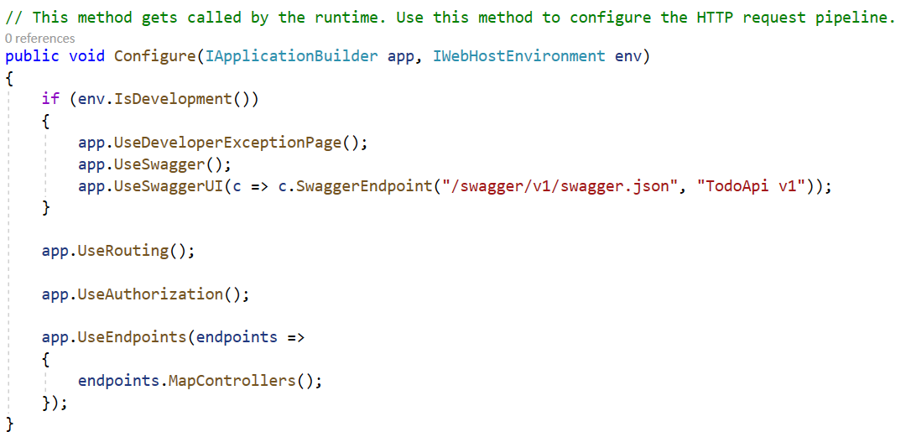
Configure Middleware Components
In the ASP.NET Core Web API application, the Middleware components are configured within the Configure method of the Startup class.

Slide 51
Map Extension Method in ASP.NET Core
If you want to insert some specific middleware logic for some specific URL, then you can do the same using the Map Extension Method in any type of ASP.NET Core Application.
The Map method Branches the request pipeline based on matches of the given request path. If the request path starts with the given path, the branch is executed else the Middleware simply ignored.
The Map Method takes the following Parameters:
app: The Microsoft.AspNetCore.Builder.IApplicationBuilder instance.
pathMatch: The request path to match.
configuration: The branch to take for positive path matches.
preserveMatchedPathSegment: if false, matched path would be removed from Request.Path and added to Request.PathBase.

Slide 52
Routing in ASP.NET Core Web API Application
Routing in ASP.NET Core Web API application is the process of mapping the incoming HTTP Request (URL) to a particular resource i.e. controller action method.
When run the application, then it will create the Route table and the Route table will contain the mapping information between the URL and the Resource.
So, when sending a request from the client to the server, then the application will check the URL in the Route table and if it found an exact, then the application will forward the request to that particular resource else it will throw an error saying resource not found.
ASP.NET Core Framework maps the incoming HTTP Requests to the action methods of Controllers based on the routes that are configured for the application.

Slide 53
Summary
Concepts were introduced:
ASP.NET Web API Architecture
Environment Setup for ASP.NET Core Web API
Demo: Create a simple web API with ASP.NET Core
Test the ASP.NET Core Web API using http-repl, Postman
ControllerBase class
Middleware in ASP.NET Core Web API
Routing in ASP.NET Core Web API Application

